Slide 1






ANALYZING AMAZON DATA
USING SQL QUERIES
Presented by: Anoop Alabnoor
www.linkedin.com/in/anoop1420

Slide 2
PROBLEMS
List all products with a discounted price below ₹500.
Find products with a discount percentage of 50% or more.
Retrieve all products where the name contains the word "Cable."
Display the difference between the average of the actual price and the discounted price for each product.
Query reviews that mention "fast charging" in their content.
Identify products with a discount percentage between 20% and 40%.
Find products that have an actual price above ₹1,000 and are rated 4 stars or above.
Find products where the discounted price ends with a 9
Display review contents that contains words like worst, waste, poor, or not good.
List all products where the category includes "Accessories."

Slide 3


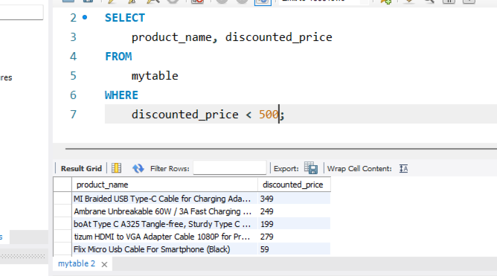

LIST ALL PRODUCTS WITH A DISCOUNTED PRICE BELOW ₹500.

Slide 4
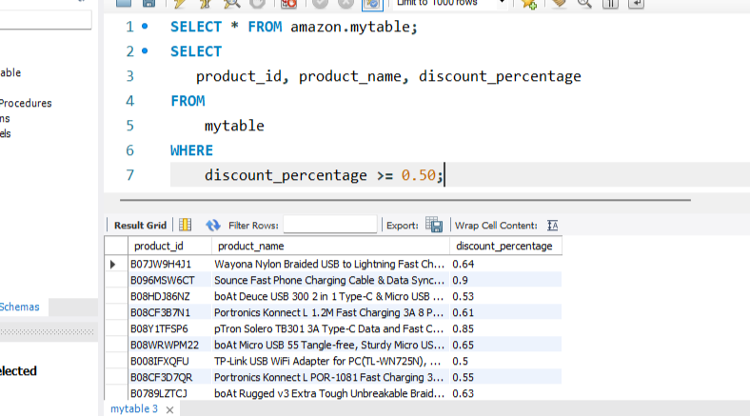
FIND PRODUCTS WITH A DISCOUNT PERCENTAGE OF 50% OR MORE.

Slide 5
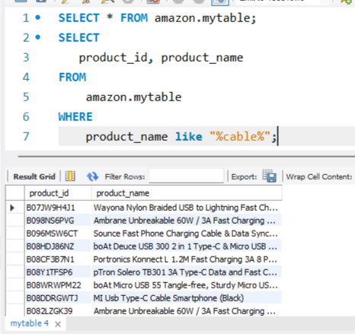
RETRIEVE ALL PRODUCTS WHERE THE NAME CONTAINS THE WORD "CABLE."

Slide 6
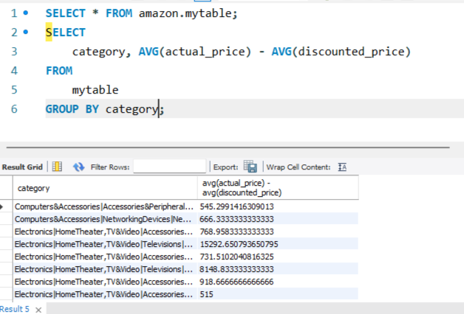
DISPLAY THE DIFFERENCE BETWEEN THE AVERAGE OF THE ACTUAL PRICE AND THE DISCOUNTED PRICE FOR EACH PRODUCT.

Slide 7
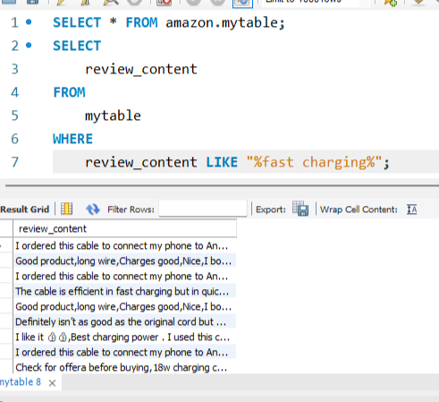
QUERY REVIEWS THAT MENTION "FAST CHARGING" IN THEIR CONTENT.

Slide 8
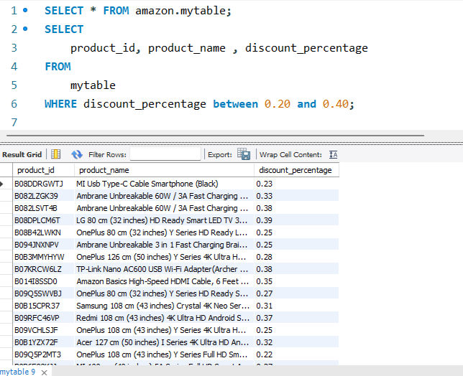
IDENTIFY PRODUCTS WITH A DISCOUNT PERCENTAGE BETWEEN 20% AND 40%.

Slide 9
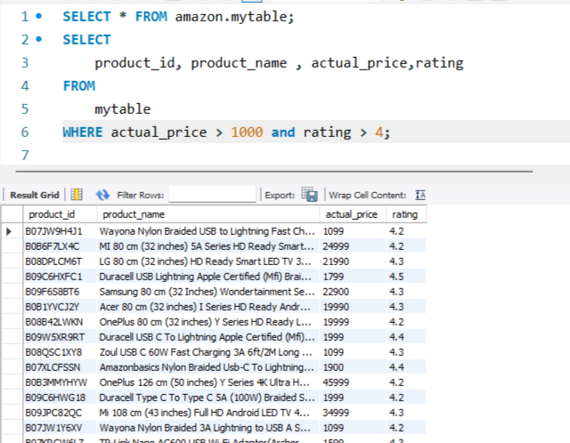
FIND PRODUCTS THAT HAVE AN ACTUAL PRICE ABOVE ₹1,000 AND ARE RATED 4 STARS OR ABOVE.

Slide 10
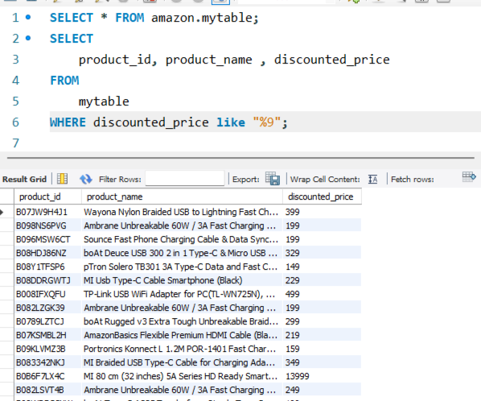
FIND PRODUCTS WHERE THE DISCOUNTED PRICE ENDS WITH A 9

Slide 11
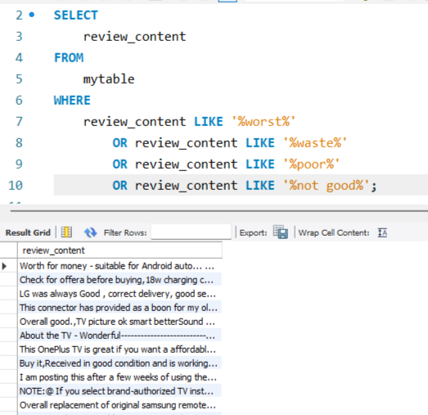
DISPLAY REVIEW CONTENTS THAT CONTAINS WORDS LIKE WORST, WASTE, POOR, OR NOT GOOD.

Slide 12
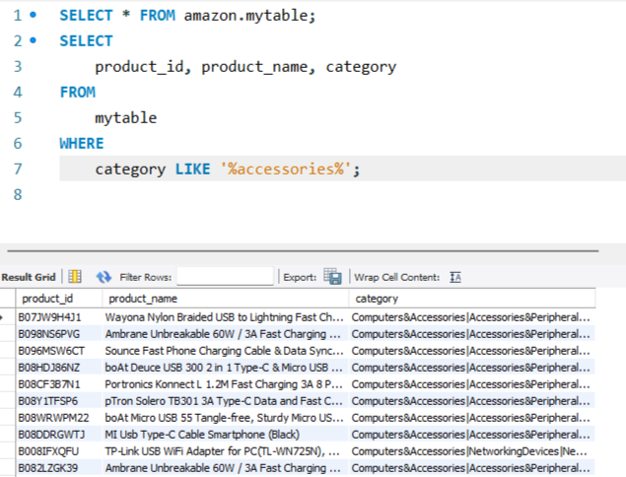
LIST ALL PRODUCTS WHERE THE CATEGORY INCLUDES "ACCESSORIES."

Slide 13



THANK YOU
www.linkedin.com/in/anoop1420

